Slide 1
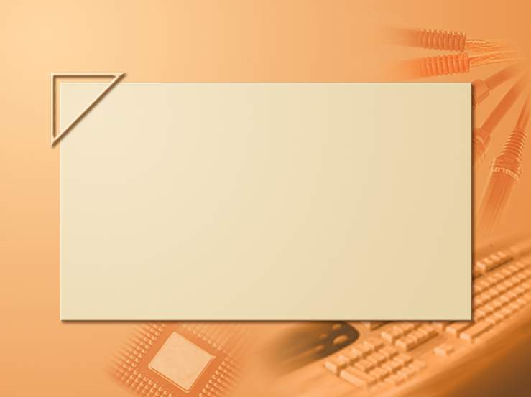
AI / ML: a Glimpse TBD by Kfir
Lecture 13-2

